Slide 1






WELLCOME TO
DREAM 71 IT

Slide 2




Omor Faruk
FOUNDER OF DREAM IT
A hardworking and Trustworthy workforce is the foundation of an Organization

Slide 3

1
MS EXCEL TUTORIAL
MS word TUTORIAL
2
3
MS PPT TUTORIAL
4
MS VBA TUTORIAL

Slide 4

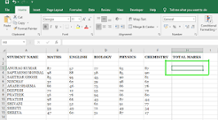
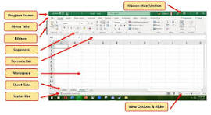
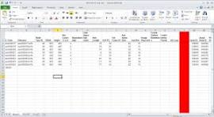
Ms EXCEL
Certainly! Microsoft Excel is a powerful spreadsheet program developed by Microsoft. It's widely used for various purposes, including data organization, analysis, calculation, and visualization. Here are some key features and functionalities of Microsoft Excel:
Grid Interface: Excel's main interface consists of a grid of cells arranged in rows and columns. Each cell can contain text, numbers, formulas, or functions.
Formulas and Functions: Excel allows users to perform calculations using formulas and functions. Formulas are expressions that perform calculations on values in cells, while functions are predefined formulas for specific calculations, such as SUM, AVERAGE, IF, VLOOKUP, etc.
Data Analysis: Excel provides various tools for data analysis, including sorting, filtering, and pivot tables. These tools allow users to analyze and summarize large datasets efficiently.

Slide 5
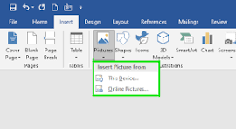
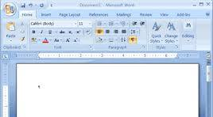
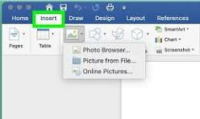
Ms World
Microsoft Word is a widely used word processing program developed by Microsoft. It is part of the Microsoft Office suite of productivity software. Here are some key features and functionalities of Microsoft Word:
Document Creation: Microsoft Word allows users to create various types of documents, including letters, reports, essays, resumes, newsletters, and more.
Formatting Tools: Word provides a wide range of formatting options for text, paragraphs, and pages. Users can change fonts, font sizes, colors, styles, alignment, indentation, spacing, and apply effects like bold, italic, underline, and strikethrough.
Templates: Word offers pre-designed templates for various types of documents, which can help users get started quickly with their projects. Templates are available for resumes, invoices, calendars, flyers, brochures, and more.
.

Slide 6
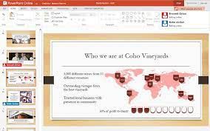


Ms PPT
Microsoft PowerPoint is a presentation program developed by Microsoft as part of the Microsoft Office suite. It allows users to create dynamic and visually appealing presentations for various purposes, including business meetings, academic lectures, training sessions, and more. Here are some key features and functionalities of Microsoft PowerPoint:
Slide Creation: PowerPoint enables users to create slides with text, images, graphics, shapes, charts, and multimedia elements such as audio and video.
Slide Layouts and Templates: PowerPoint offers a variety of pre-designed slide layouts and templates to help users get started with their presentations quickly. Users can choose from different themes and customize them according to their needs.
Slide Transitions and Animations: PowerPoint allows users to add slide transitions and animations to make their presentations more engaging and dynamic.

Slide 7
Ms VBA
Certainly! Microsoft Excel is a powerful spreadsheet program developed by Microsoft. It's widely used for various purposes, including data organization, analysis, calculation, and visualization. Here are some key features and functionalities of Microsoft Excel:
Grid Interface: Excel's main interface consists of a grid of cells arranged in rows and columns. Each cell can contain text, numbers, formulas, or functions.
Formulas and Functions: Excel allows users to perform calculations using formulas and functions. Formulas are expressions that perform calculations on values in cells, while functions are predefined formulas for specific calculations, such as SUM, AVERAGE, IF, VLOOKUP, etc.
Data Analysis: Excel provides various tools for data analysis, including sorting, filtering, and pivot tables. These tools allow users to analyze and summarize large datasets efficiently.

Slide 8


